Slide 1

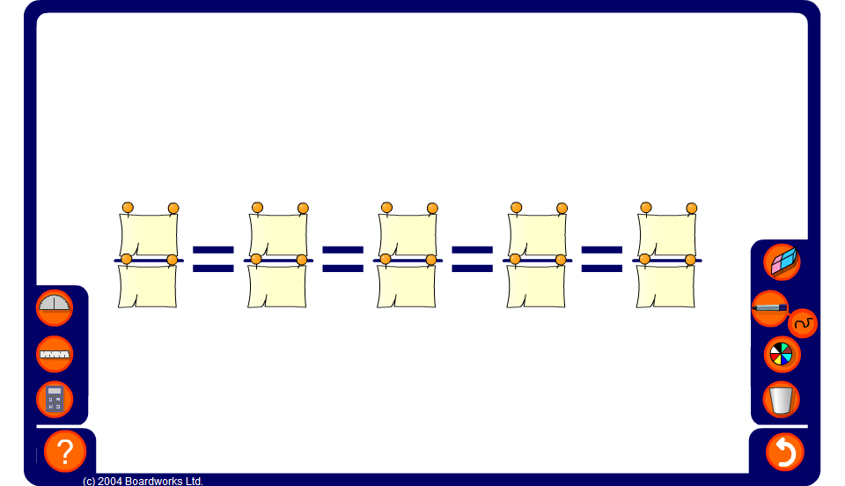


Equivalent fractions
Notes:
Use this activity to generate patterns of equivalent fractions.
Stress that every fraction on the board is exactly the same fraction written in a different way. Establish that there are infinitely many ways to write the same fraction.
When all of the equivalent fractions have been revealed ask pupils how we could convert between any two given fractions on the board by multiplying and/or dividing the numerator and the denominator by the same number.
Link:
N8 Ratio and Proportion – Using scale factors.

